Slide 1
Toronto Traffic Collision Prediction Model
By: Rakeen Ahmed

Slide 2
Agenda
Project Overview
Data Overview
Data Exploration/EDA and Data Visualization
Modeling
Collision Risk Map
Feature Importance
Feature Interpretation
Recommendations
Questions

Slide 3
Project Overview
Background
Problem Statement
Objective

Slide 4
Background
Traffic Collisions: Major public health concern in cities worldwide today
No. 1 cause of mortality between ages 15-29
Toronto Stats:
3rd leading cause of mortality
1,581 deaths in the last 10 years

Slide 5
Background
Vision Zero Program
Goal: Eliminate deaths and serious injuries resulting from collisions
Approach: ”Data Driven insights based on past collision data to inform road design and infrastructure improvements”
Toronto lags behind behind major European and American cities in terms of road safety

Slide 6
Problem Statement
The project arose from the need to provide data-driven insights based on a combination of road design and infrastructure, traffic volumes, and previous traffic collisions datasets to inform road safety and design improvements for the Vision Zero program, as well as to identify the key drivers of collision risk in terms of street design and infrastructure

Slide 7
Problem Statement
The project arose from a need to provide data-driven insights to inform road design and infrastructure improvements
The goal is to identify the key drivers of collision risk in terms of street design and infrastructure
Data sources: road infrastructure

Slide 8
Objective
Objective: Develop a collision prediction model for the City of Toronto
Goal:
Estimate and map the risk of traffic collisions on a given road and identify high-risk road segments
Identify the key design and infrastructure features driving collision risk to inform design changes.
Method: Utilize road infrastructure (bike lanes, traffic cameras, speed limits), design, and historical collision data
Result: Understanding key factors driving collision risk will inform effective design changes and lead to reduced collision

Slide 9
Data Overview
Data Sources
Merging Datasets
Exclusions

Slide 10
Data Sources
Toronto Centreline Road Network
All Traffic Collisions
Traffic Volumes
Centreline Lanes
Automated Speed Enforcement
Cycling Network
Pedestrian Crossings
Traffic Calming
Traffic Cameras
Posted Speed Limits
Sensitive Zones
KSI

Slide 11
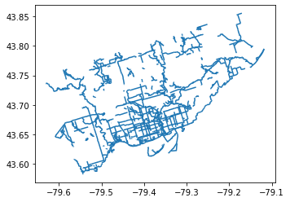
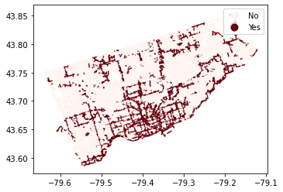
Merging Datasets
Datasets were merged using a spatial join using GeoPandas using exact or radius search.
Toronto Road Network was used as the base dataset
Get design and infrastructure features for all road segments for our prediction model.

Slide 12
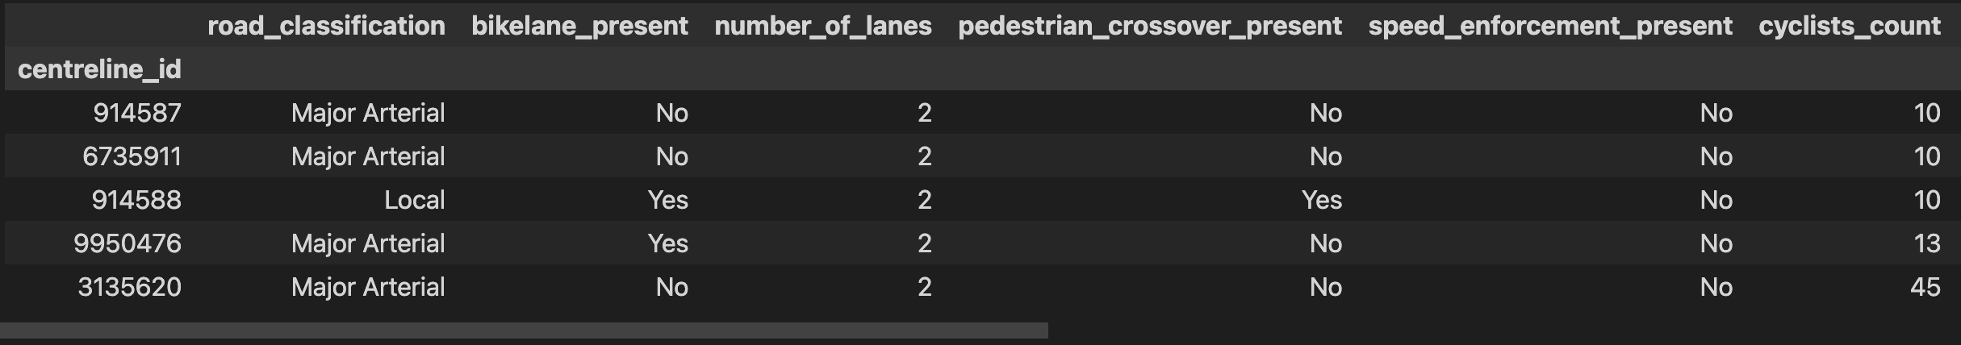
Final Dataset & Exclusions
Final Dataset contained 13,979 rows and 26 columns. (All features not shown)
Excluded all collisions before 2016 from the collisions and KSI datasets.

Slide 13
EDA & Data Visualization
Feature Engineering
Data Visualization

Slide 14
Feature Engineering
Collision Rate: The rate of collision of a road segment,
Derived from the total count of collisions divided by 1000 road users (pedestrians, vehicles, trucks etc.)
Measure of frequency of collision on each road segment by traffic volume
Collision Class: Bins of collision counts for use in classification models.
Speed Hump Present: Converted speed hump count to a flag

Slide 15
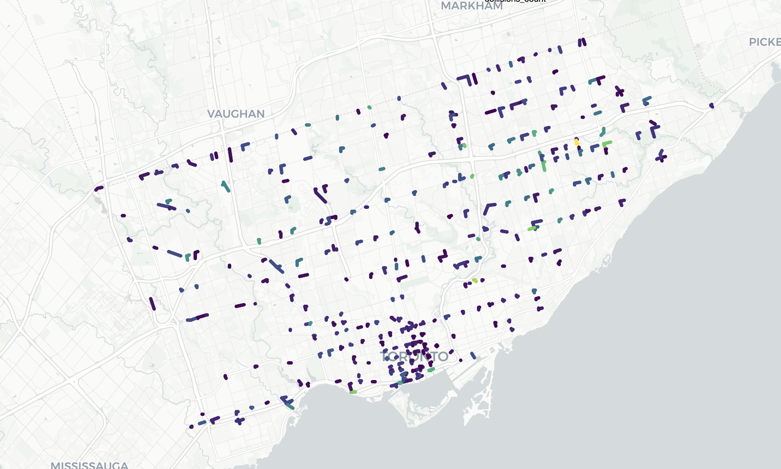
Data Visualization
Road Segments with the highest number of collisions

Slide 16
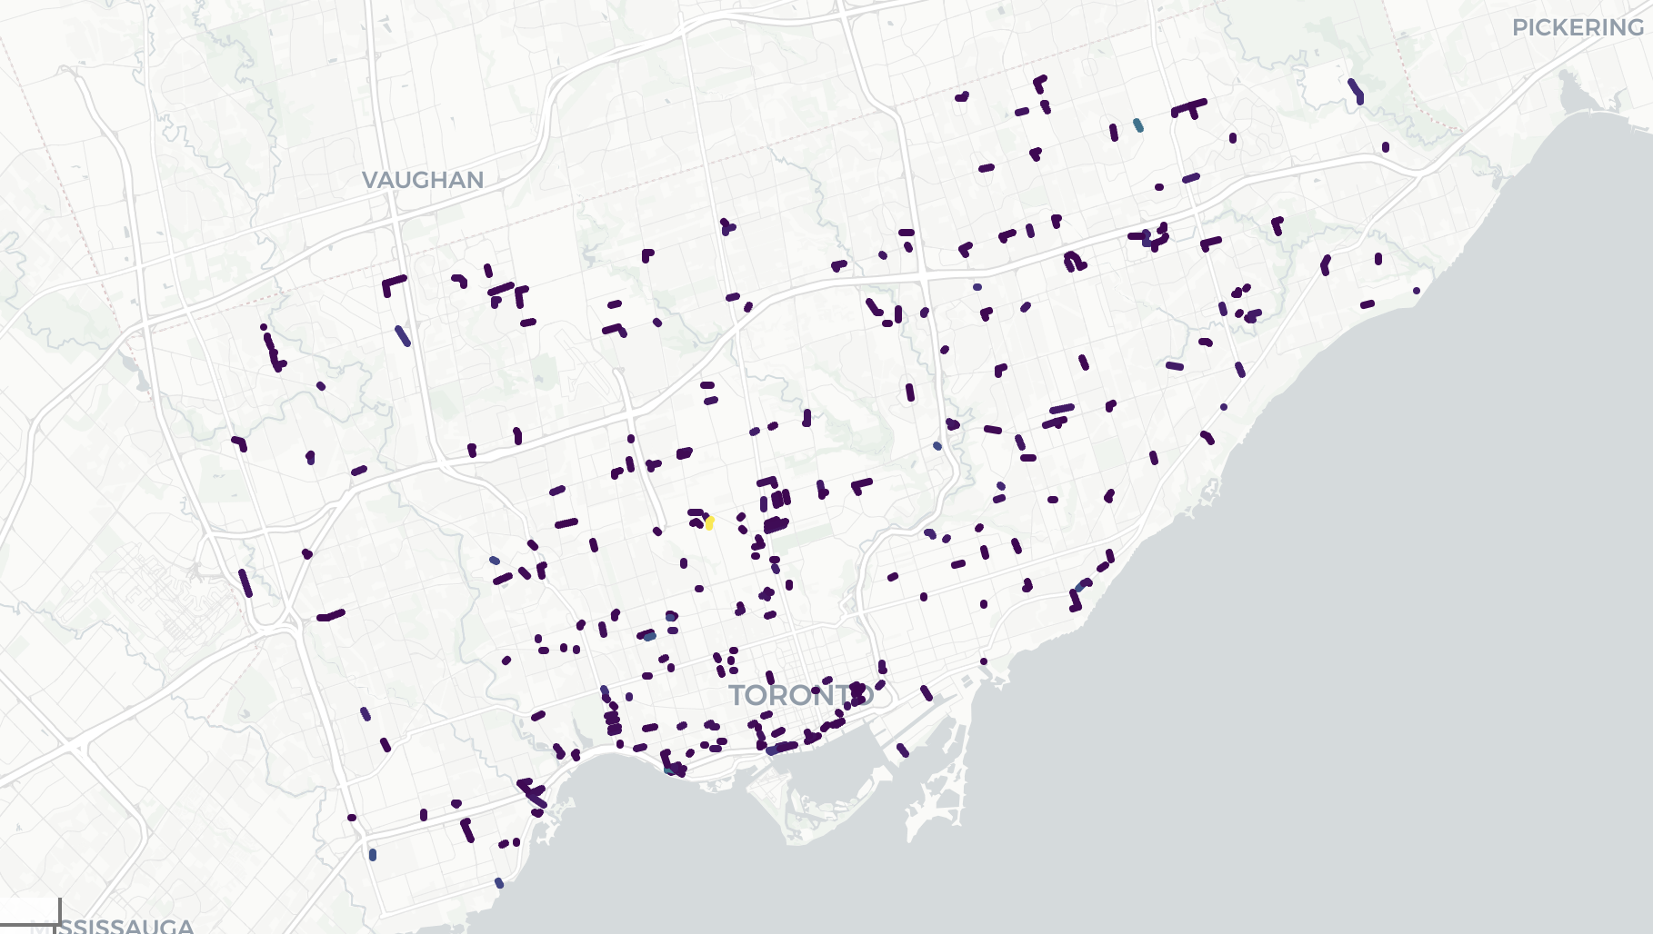
Data Visualization
Road Segments with the highest collision rates.

Slide 17
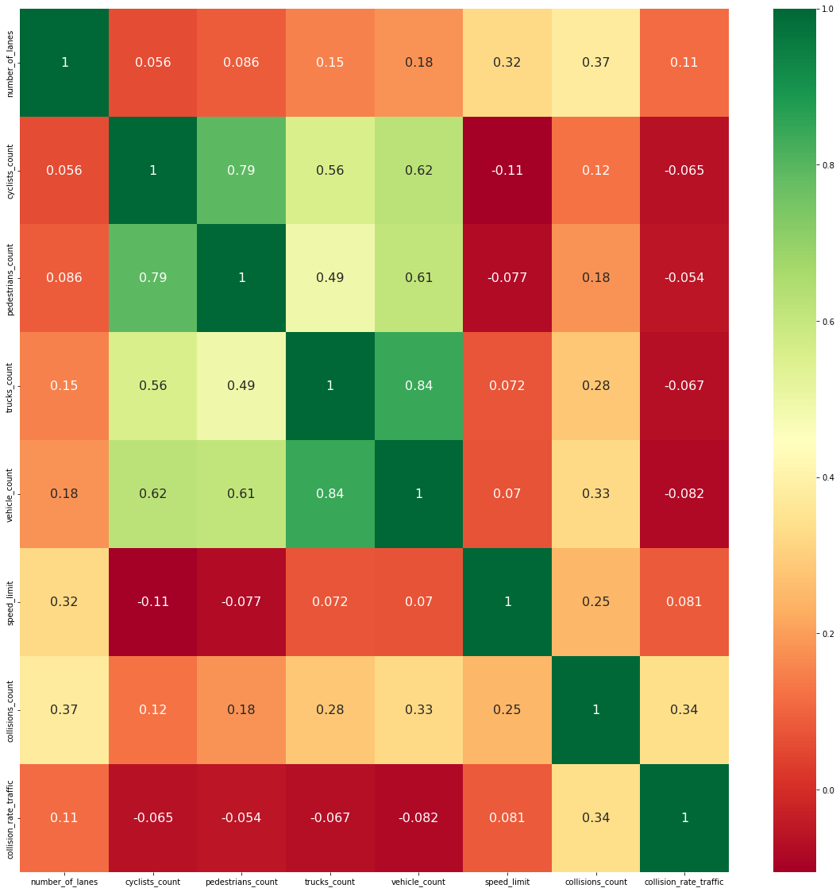
Data Visualization

Slide 18
Modeling
Algorithms
Modeling Breakdown
Metrics
Model Comparison
Model Selection

Slide 19
Algorithms
Decision Tree
Random Forest
Neural Network
AdaBoost
Linear Regression
Logistic Regression
KNN
XGBoost

Slide 20
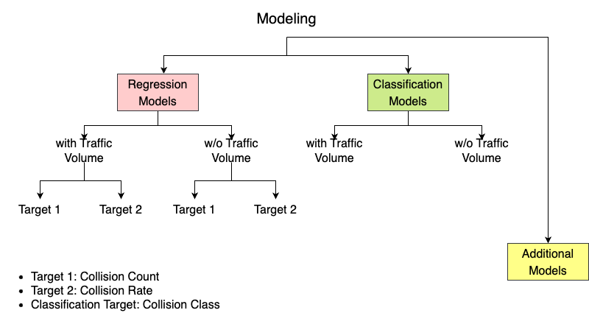
Modeling Breakdown

Slide 21
Metrics
Regression Models
Mean Absolute Percentage Error
Average percentage difference between the actual and predicted values
Normalized Mean Absolute Error
MAE measures the average absolute difference between the actual and predicted values
MAE divided by the range of y-values to to normalize the error
Normalization enables comparison between diff. target variables
Classification Models
Accuracy

Slide 22
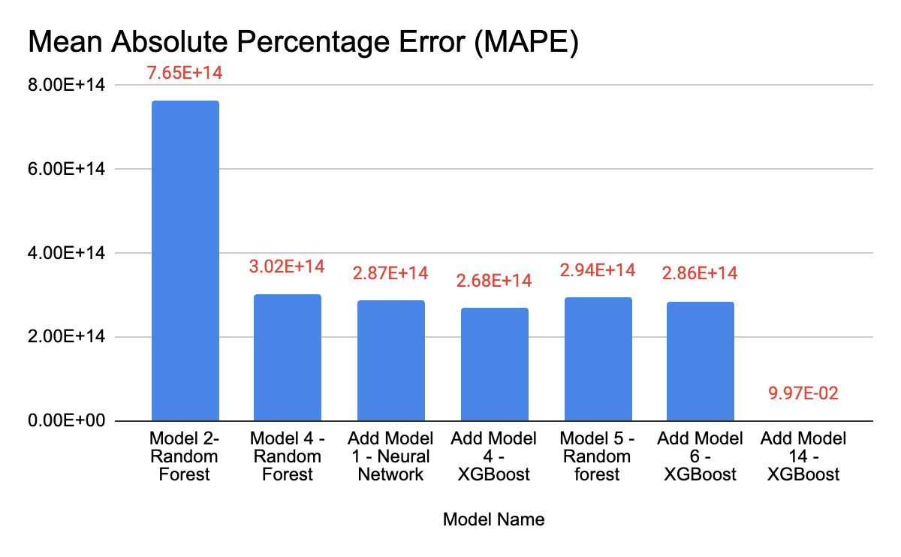
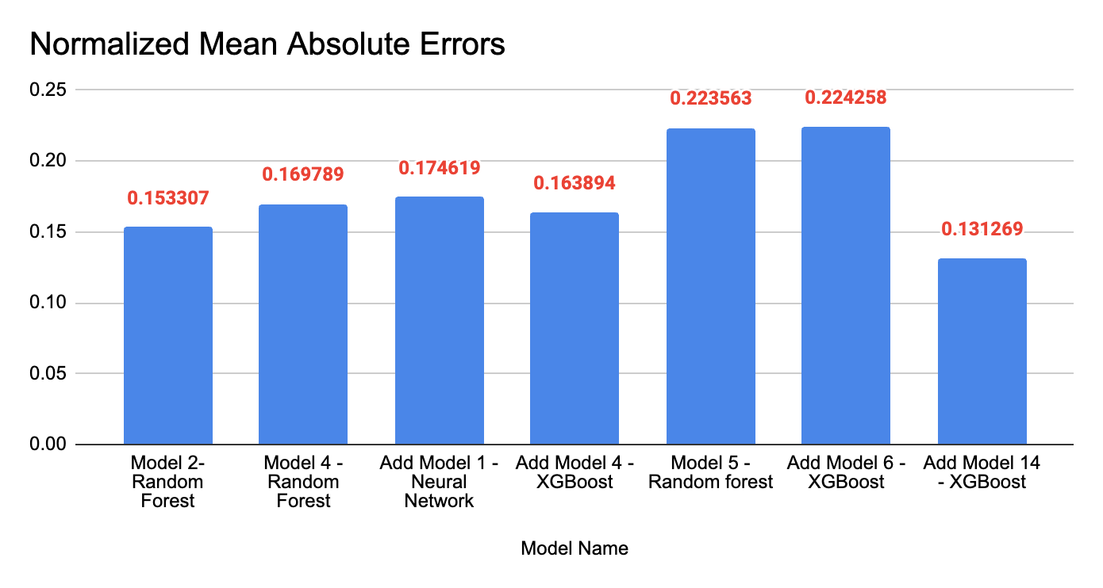
Model Comparison - Regression

Slide 23
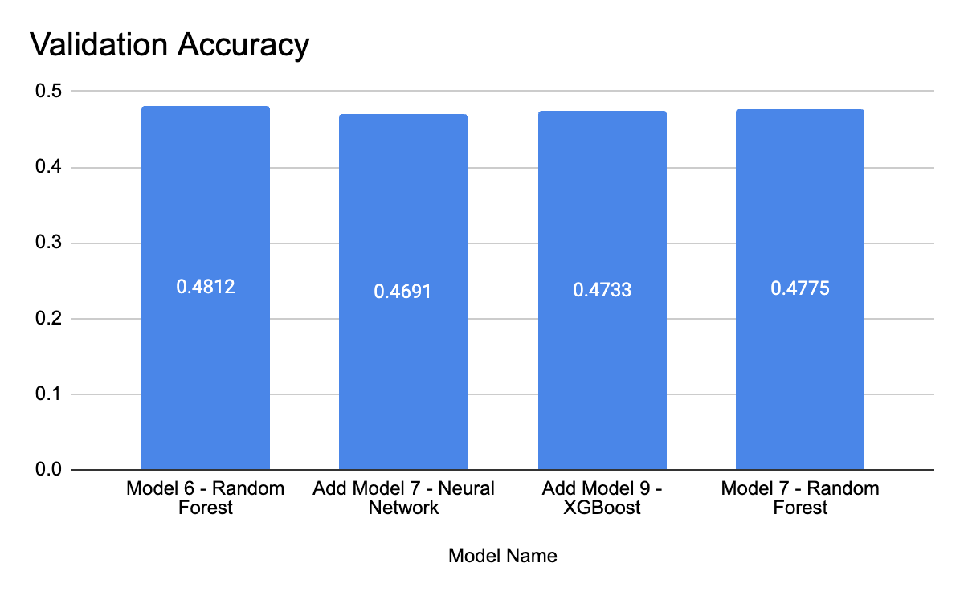
Model Comparison - Classification

Slide 24
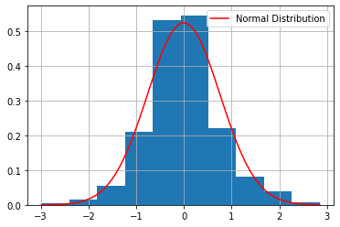
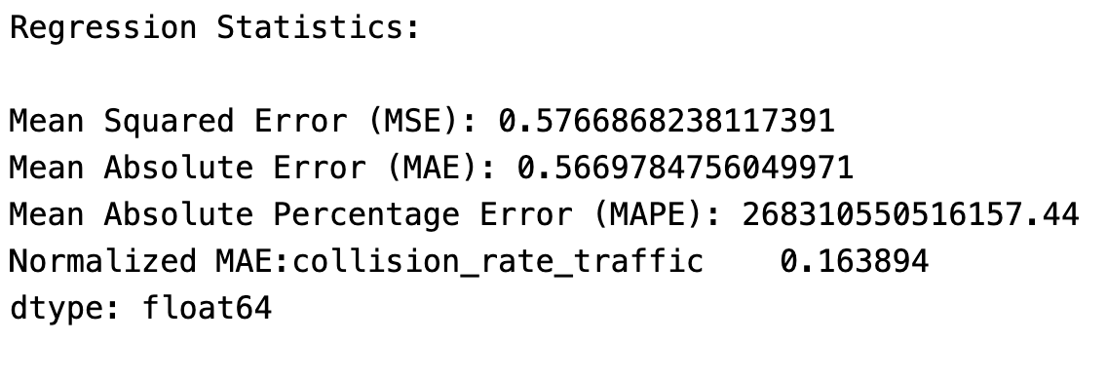
Model Selection
Add Model 4 – XGBoost was selected as the best model as it had a combination of low MAPE score as well as low Normalized MAE.
Regression model preferred.
XGBoost Models are very fast to train.
Residuals of the model are normally distributed.

Slide 25
Collision Risk Map

Slide 26
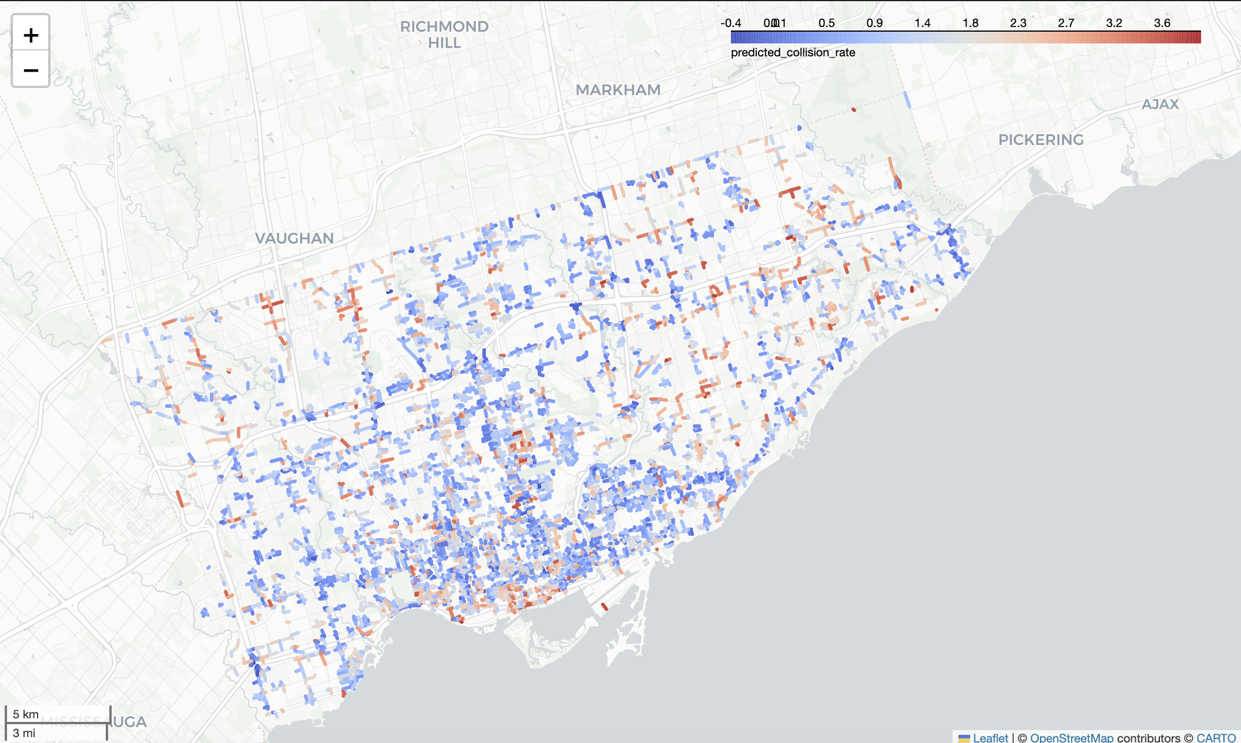
City of Toronto

Slide 27
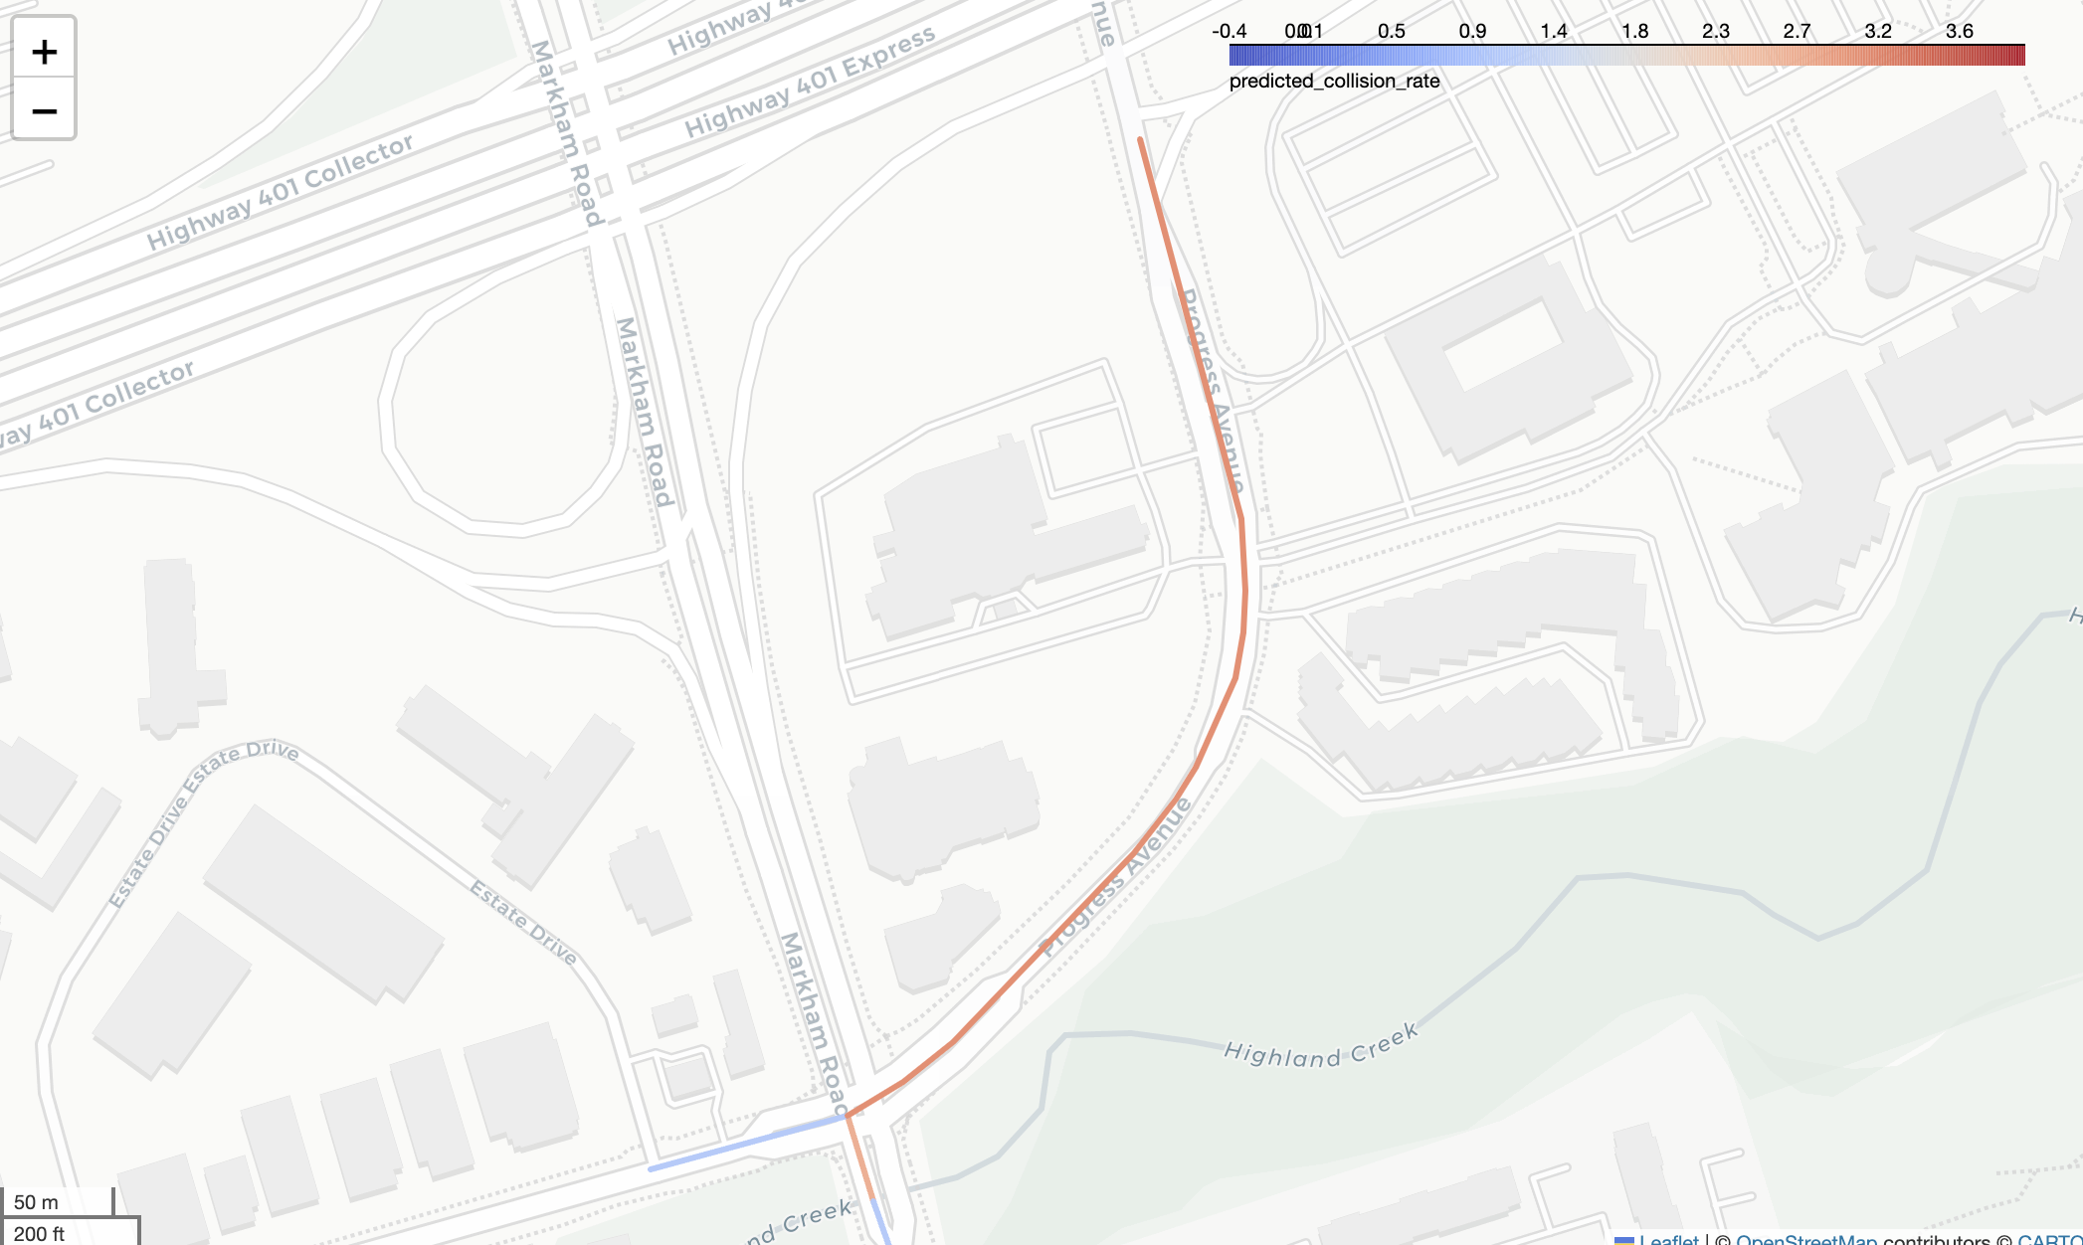
Centennial College
Collision Rate
Predicted: 3.01 per 1000 road users
Actual: 3.44 collisions per 1000 road users
Collision Count
Predicted: 150 (Collision Cap)
Actual: 624

Slide 28
Feature Importance
Including Volume
High Collision Rate Segments

Slide 29
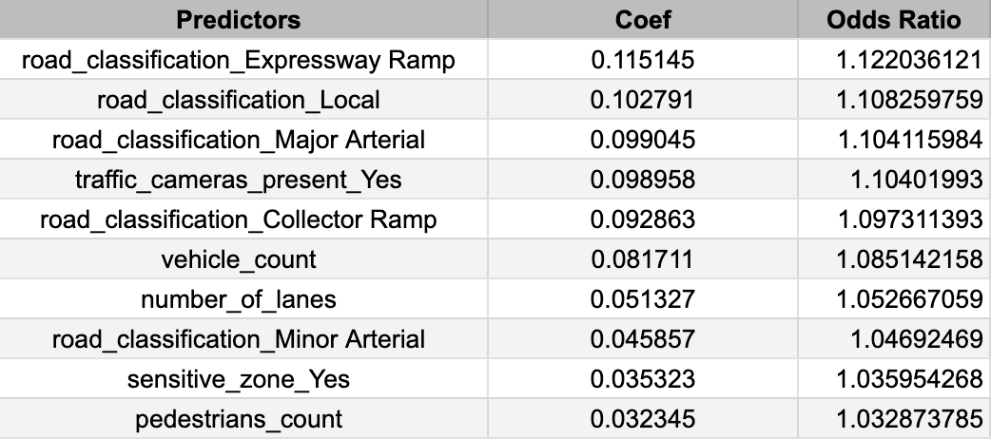
Feature Importance – Best Model
Feature Importance of Add Model 4 - XGBoost

Slide 30
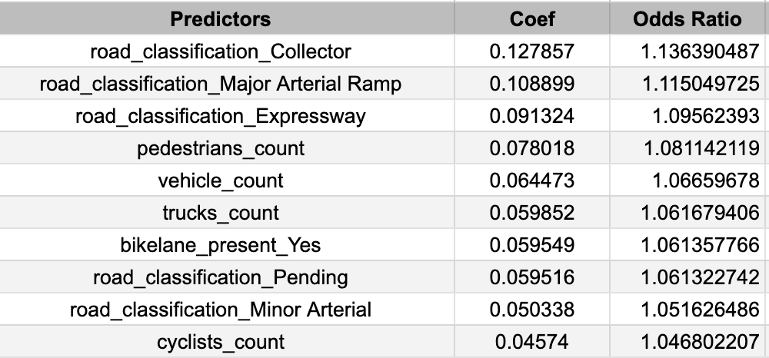
Feature Importance – High Collision Rate
Feature Importance of Add Model 14 - XGBoost

Slide 31
Feature Interpretation

Slide 32
Feature Interpretation
Road Classification: Major Arterial – 1.10
Collision rates are 10% higher on Major Arterial Roads as compared to all other road classes.
Road Classification: Minor Arterial – 1.04
Collision rates are 4% higher on roads classified as Minor Arterials.
Vehicle Count – 1.08
For each additional 1000 vehicles on the road segment, the collision rate increases 8%.
Number of Lanes - 1.05
For each additional lane on the road segment, the collision rate increases 5%

Slide 33
Recommendations
Recommendations
Future Work

Slide 34
Recommendations
Toronto Traffic Services should focus on these road segments:
Road Classification: Major or Minor Arterial
High Vehicle Count
High Number of Lanes
Use the collision prediction model to identify road segments that require design and safety improvements.

Slide 35
Future Work
Include additional road features in the model – Avg. Traffic Speeds, Traffic Signals, 311 requests
Develop separate collision models – Roads with high collision counts or high pedestrian counts, downtown vs suburbs.
Map collision risk for all road segments in Toronto.

Slide 36
Thank you!

